Slide 1

Attacks on Healthcare Facilities
A Comprehensive Analysis
from War Zone Conflict Countries
GROUP 06

Slide 2


Index
Who we are?
1
2
Problem Statement
Target Audiences
3
4
Key Findings/Analysis
?
Surprise

Slide 3












Where our story begin?
Mariam
Mohammad
Fahim
Batool
Adel
Abed
Victoria

Slide 4

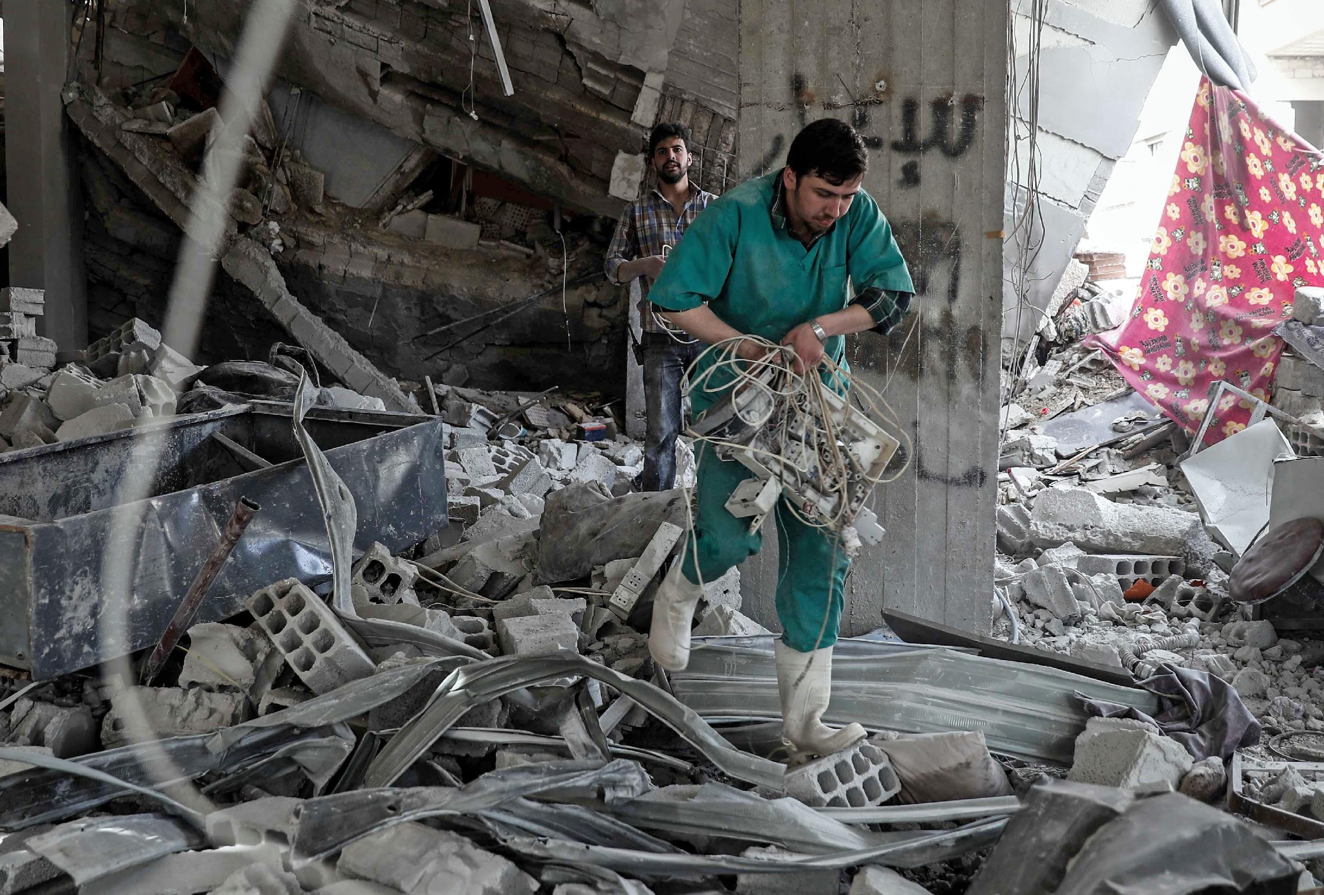


Problem Statement
Violence against healthcare facilities in conflict areas
Targeted Facilities
Attacks Types and its Impact
People Affected in Numbers (deaths and injuries)

Slide 5


Target Audiences
The Healthcare Workers
People in war-affected areas
Peace and war Researchers

Slide 6
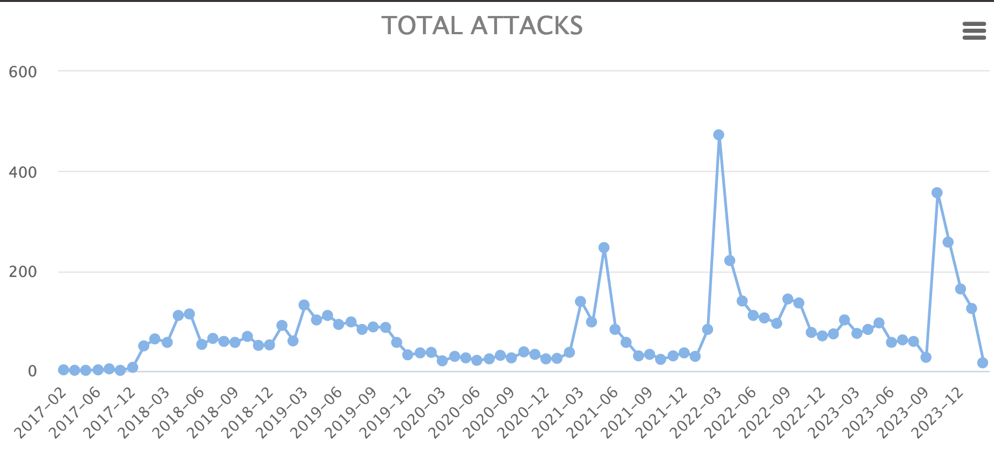
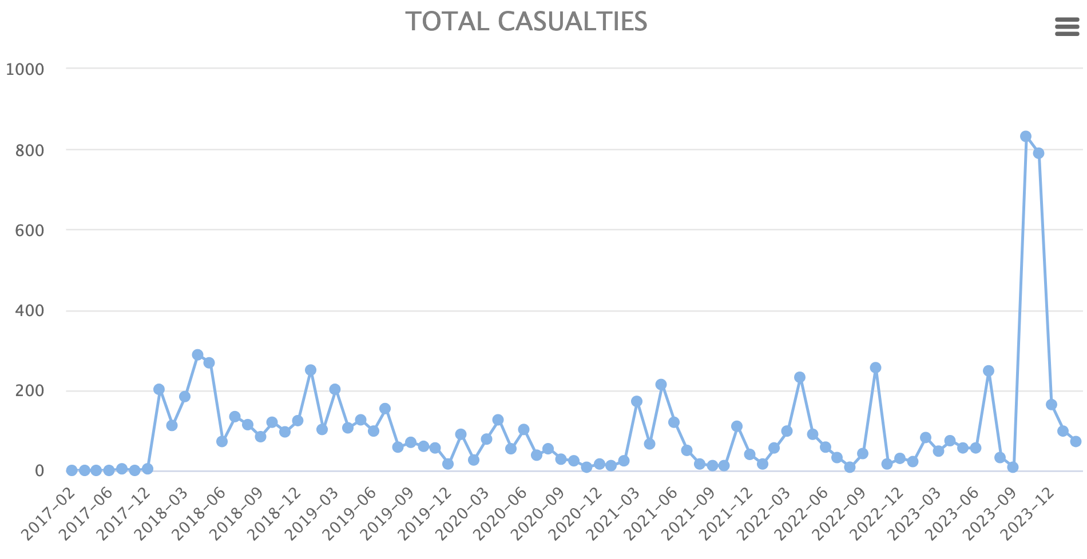
Analysis / Findings
Attacks
Countries
Injured
Death
6277
21
4056
1902

Slide 7
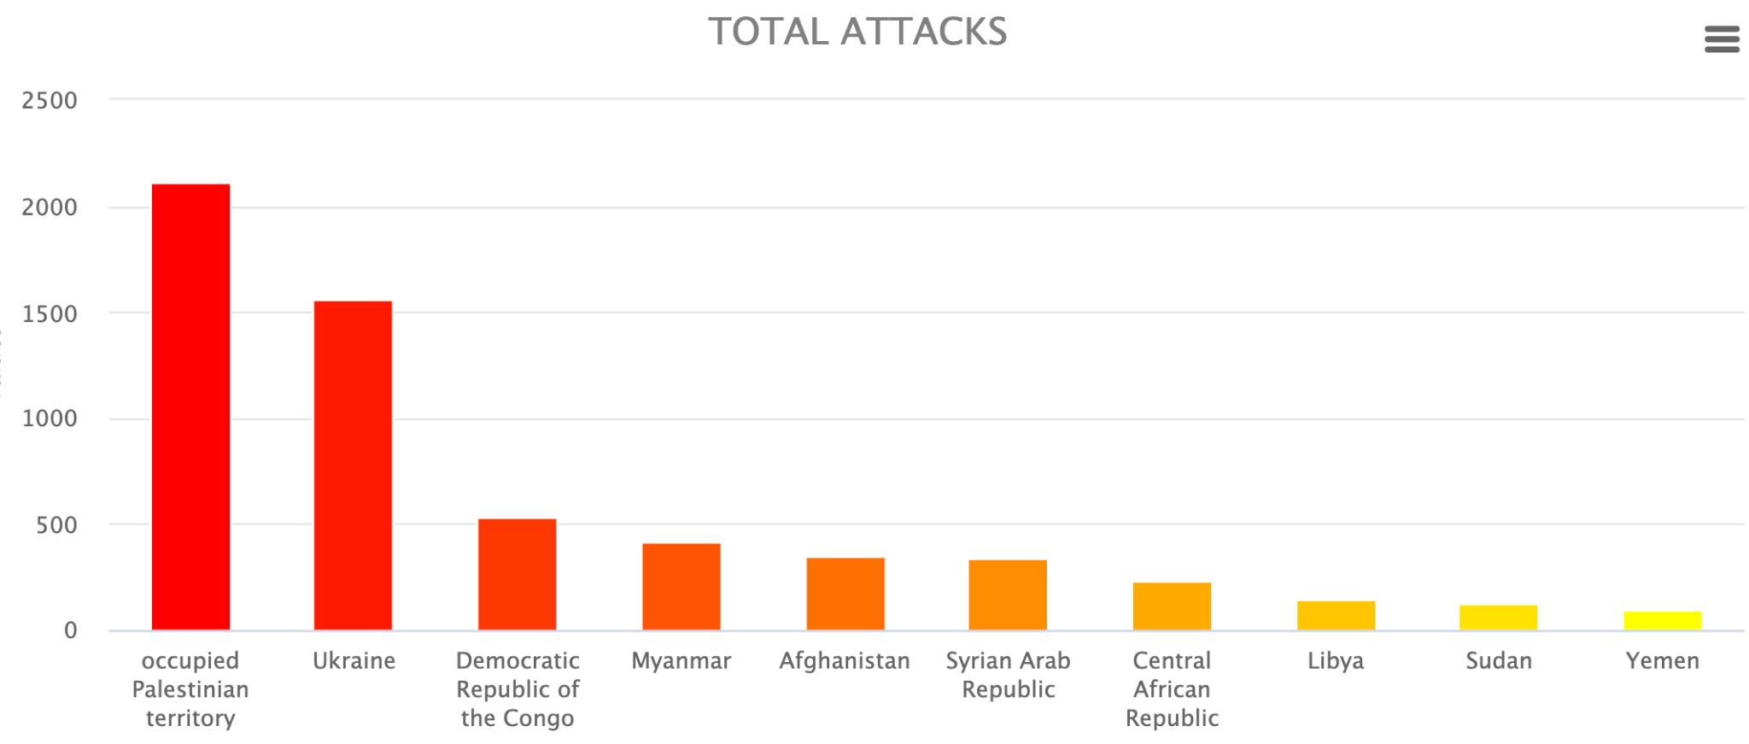
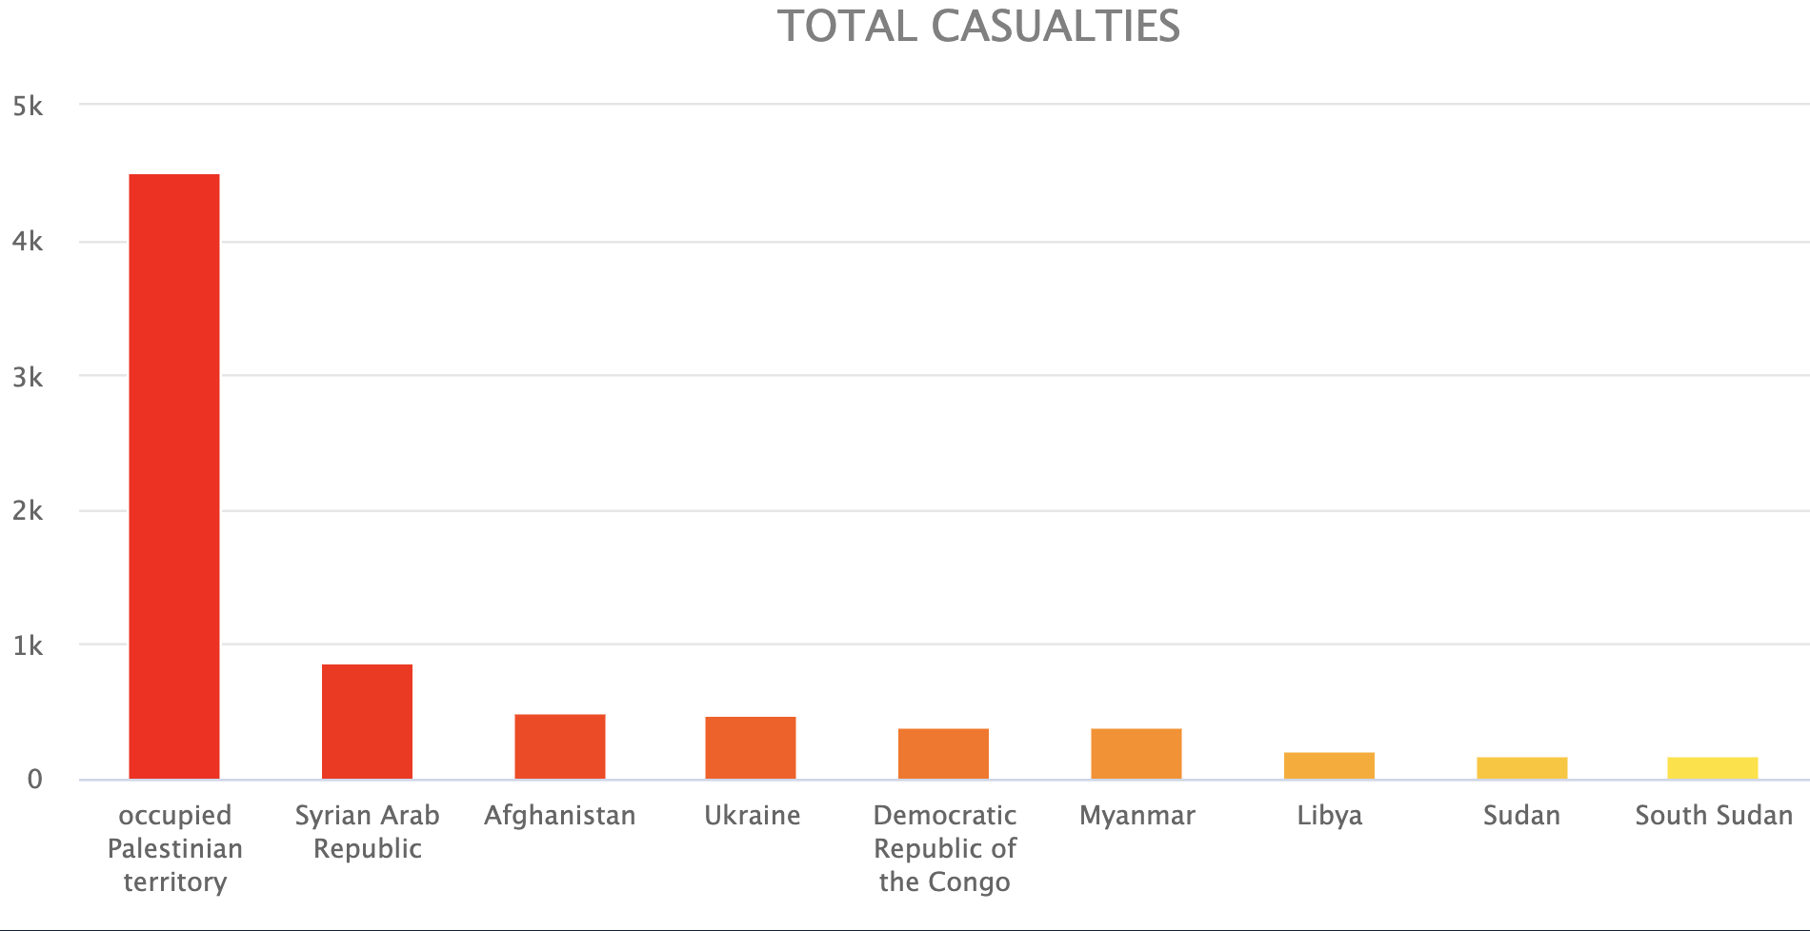
Analysis / Findings
More attacks do not mean more casualties !!!
Casualties to attacks ratio
Syria: 1.9
Palestine: 1.4
Afghanistan: 1.2
Haiti: 0.14
Ukraine: 0.2
Central African Republic: 0.3

Slide 8

Analysis / Findings
Common Attack Types:
Ratios tells more..
Violence with heavy weapons: 2425
Violence with individual weapons: 1943
Obstruction to health care delivery: 1381
Psychological violence/threat of violence/intimidation: 1153
Removal of health care assets: 687
Armed or violent search of health care personnel: 517
…..
…..
Setting fire: 145
Sexual assault: 13
Palestine (ratio = 1.9)
Violence with weapons
Haiti (ratio = 0.14):
Abduction/Arrest/Detention of health personnel or patients

Slide 10
“
The time is always right to do what is right.
Martin Luther King Jr.
Notes:
If you do not go after what you want, you'll never have it.

Slide 11
?%
Of students…..

Slide 12
Beyond the Numbers
Economic Vulnerability
Reduced Essential Services
Social and Psychological Distress

Slide 13
Insights and Unforeseen Outcomes
Resilience of Afghan Women
Interconnectivity of Issues
Limited International Impact

Slide 14
Towards a Better Future
Recap of Key Findings
Importance of Addressing the Issue
Call to Action
This is a description of the whole thing

Slide 15

Thank You!
Team 6

Slide 16
